Slide 1



Lab5
View in Power BI
Last data refresh:
3/2/2024 6:52:44 PM UTC
Downloaded at:
3/2/2024 8:20:39 PM UTC

Slide 2
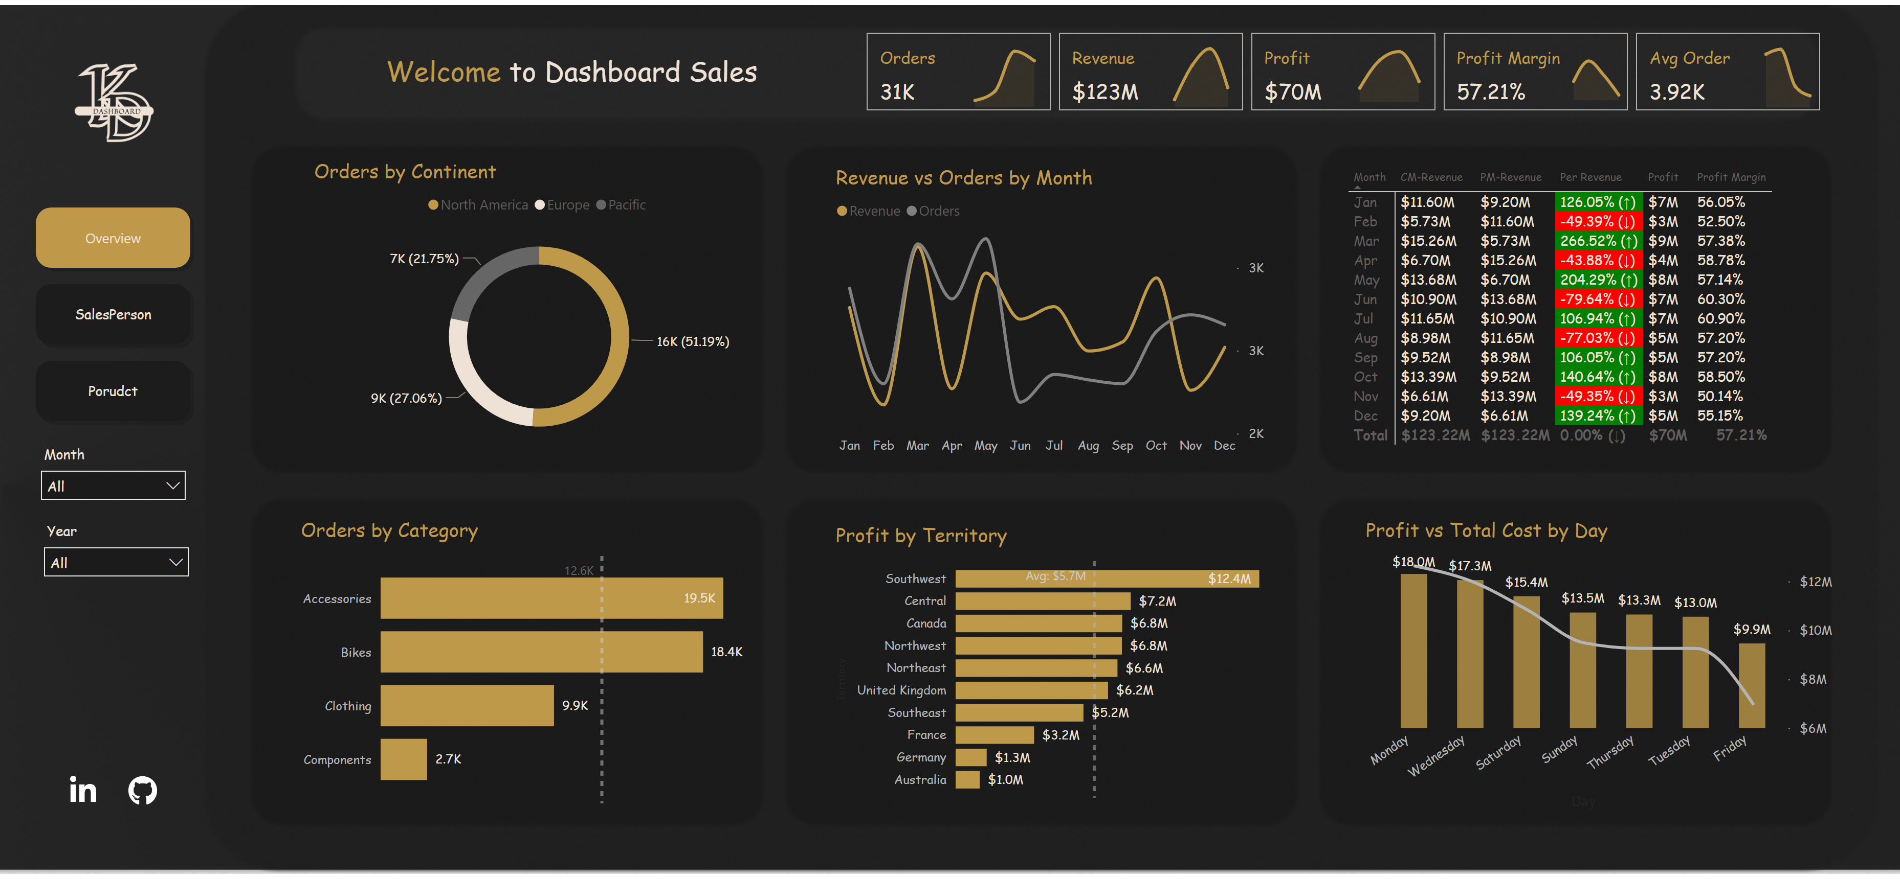
Overview
Notes:
cardVisual
No alt text provided
Revenue vs Orders by Month
No alt text provided
pivotTable
No alt text provided
Profit vs Total Cost by Day
No alt text provided
donutChart
No alt text provided
clusteredBarChart
No alt text provided
clusteredBarChart
No alt text provided
stackedAreaChart
No alt text provided
stackedAreaChart
No alt text provided
stackedAreaChart
No alt text provided
stackedAreaChart
No alt text provided
stackedAreaChart
No alt text provided
slicer
No alt text provided
slicer
No alt text provided
textbox
No alt text provided
pageNavigator
No alt text provided
image
No alt text provided
image
No alt text provided
image
No alt text provided

Slide 3
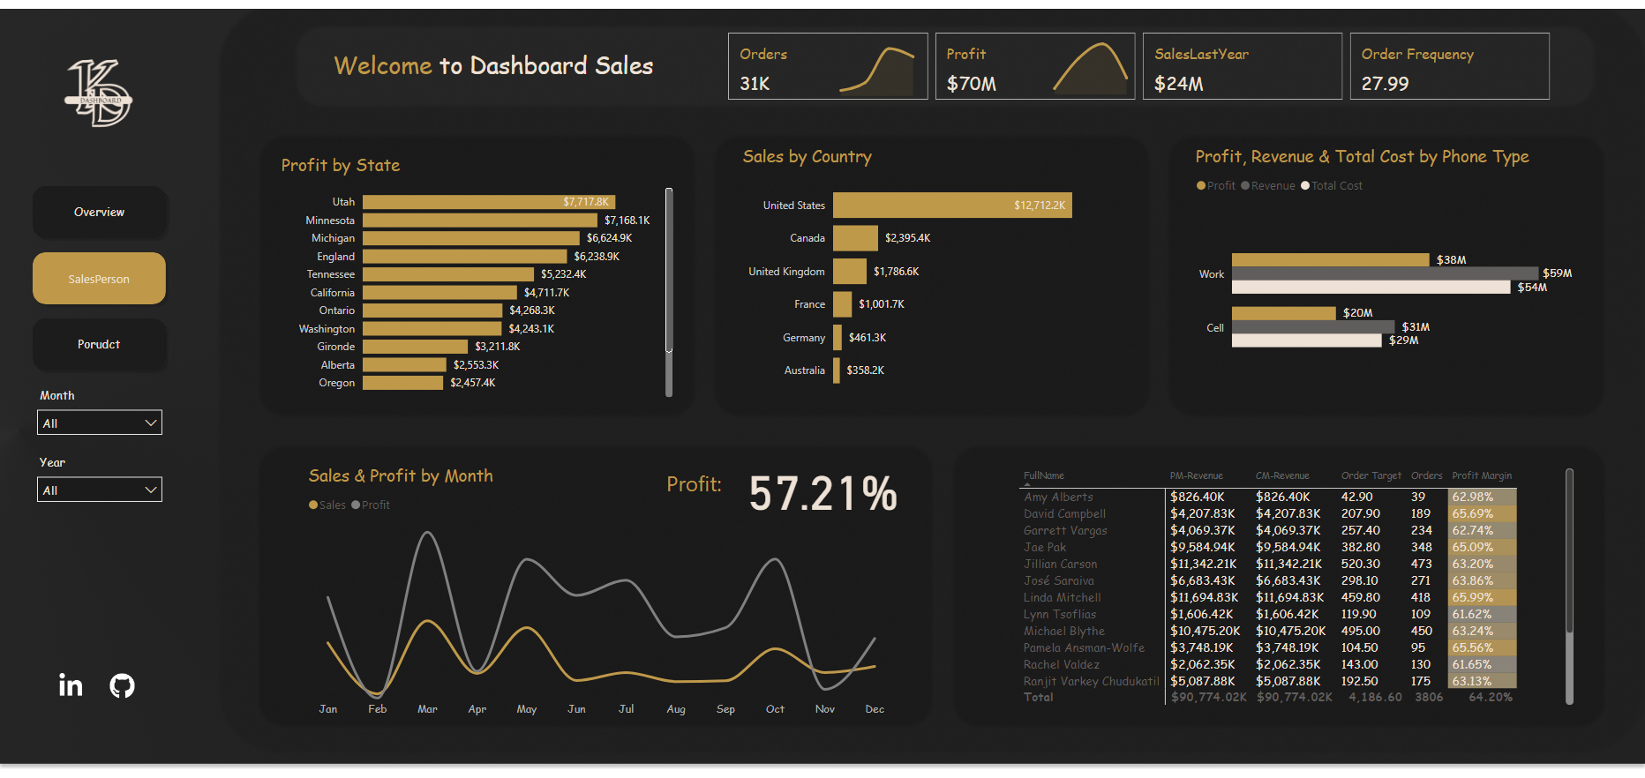
SalesPerson
Notes:
pivotTable
No alt text provided
Profit by State
No alt text provided
Sales by Country
No alt text provided
Profit, Revenue & Total Cost by Phone Type
No alt text provided
Sales & Profit by Month
No alt text provided
cardVisual
No alt text provided
stackedAreaChart
No alt text provided
stackedAreaChart
No alt text provided
slicer
No alt text provided
slicer
No alt text provided
pageNavigator
No alt text provided
image
No alt text provided
image
No alt text provided
image
No alt text provided
textbox
No alt text provided
card
No alt text provided
textbox
No alt text provided

Slide 4
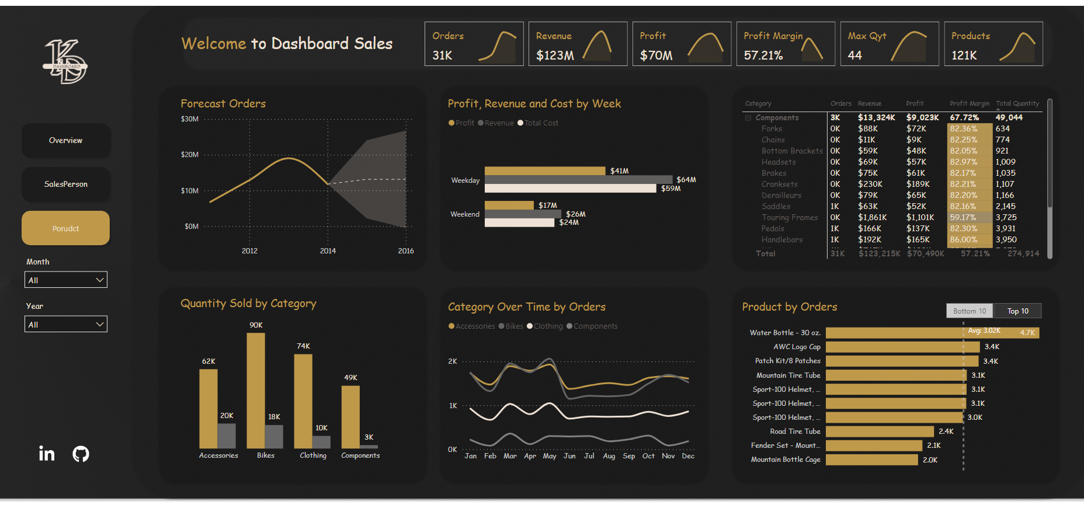
Porudct
Notes:
pivotTable
No alt text provided
Quantity Sold by Category
No alt text provided
Profit, Revenue and Cost by Week
No alt text provided
Product by Orders
No alt text provided
slicer
No alt text provided
Category Over Time by Orders
No alt text provided
Forecast Orders
No alt text provided
cardVisual
No alt text provided
textbox
No alt text provided
stackedAreaChart
No alt text provided
stackedAreaChart
No alt text provided
stackedAreaChart
No alt text provided
stackedAreaChart
No alt text provided
stackedAreaChart
No alt text provided
stackedAreaChart
No alt text provided
slicer
No alt text provided
slicer
No alt text provided
pageNavigator
No alt text provided
image
No alt text provided
image
No alt text provided
image
No alt text provided

